Slide 1

Intro to Scanning and Network Analysis
Maciej Szwoch

Slide 2



Agenda
Intro
TCP Protocol
Nmap
Demo

Slide 3

Why do we Pentest?

Slide 4
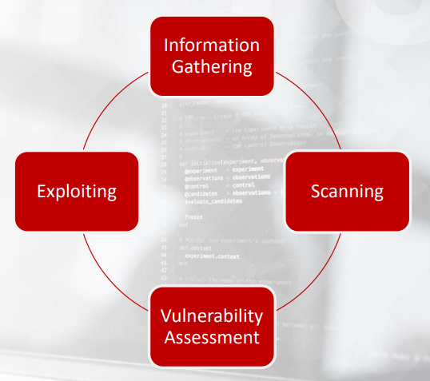
Pentest Life Cycle

Slide 5
Pentest Life Cycle

Slide 6
TCP
Transmission Control Protocol

Slide 7
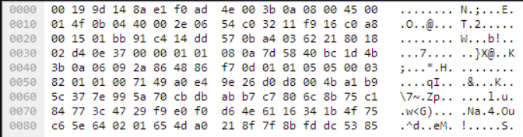
What is a packet?
Its just a bunch of bytes
Protocols define the format, ordering of the
Bytes

Slide 8
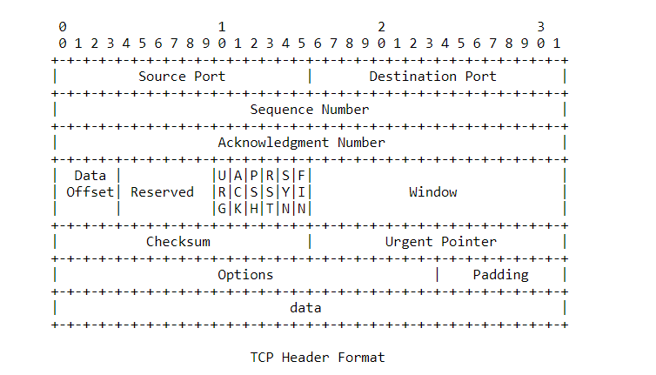
TCP Protocol
Described by RFC 793
Connection Oriented Protocol
Offers reliable transport and data integrity
TCP “packets” are called Segments

Slide 9
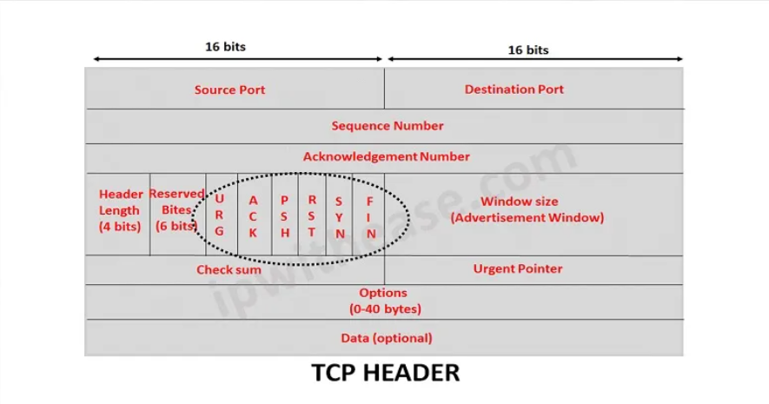
TCP Flags

Slide 10
TCP Flags
Syn – Start a connection, “Synchronizes” sequence numbers
Ack -- acknowledge the successful receipt of a packet
Rst – Drops current connection. Also can indicate a port is closed
Fin – Used to Gracefully end a connection
Urg – Obsolete. Tell client to use URG pointer to jump to part of data packet
Psh -- Tell the client/server to go ahead and send what data it has to the receiving application even if its buffer hasn't filled up

Slide 11
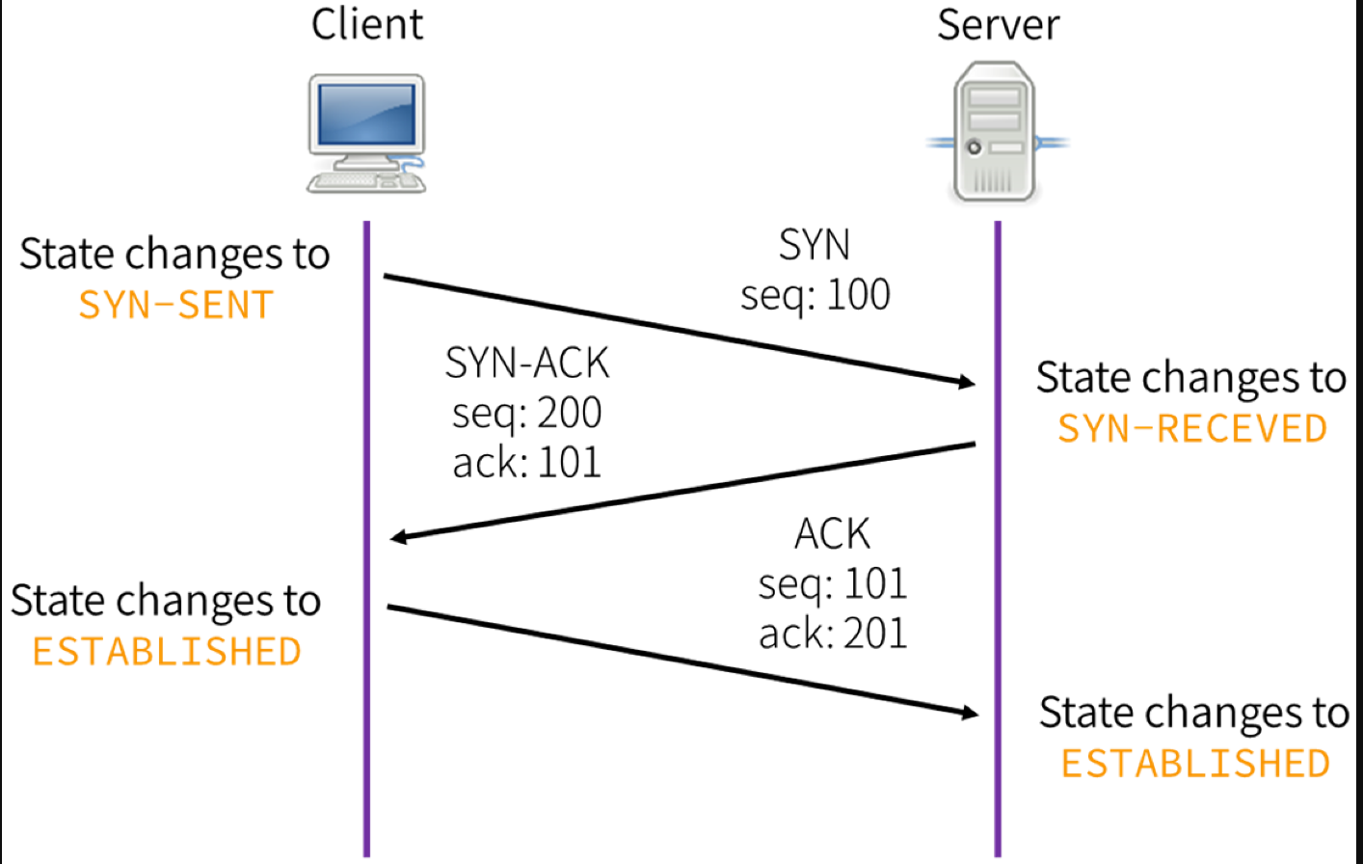
TCP Hand-Shake Open Port
The Sequence number is randomly generated
Sequence numbers are generally very big
The Ack number is always a simple increment
of the last packet processed through the buffer

Slide 12
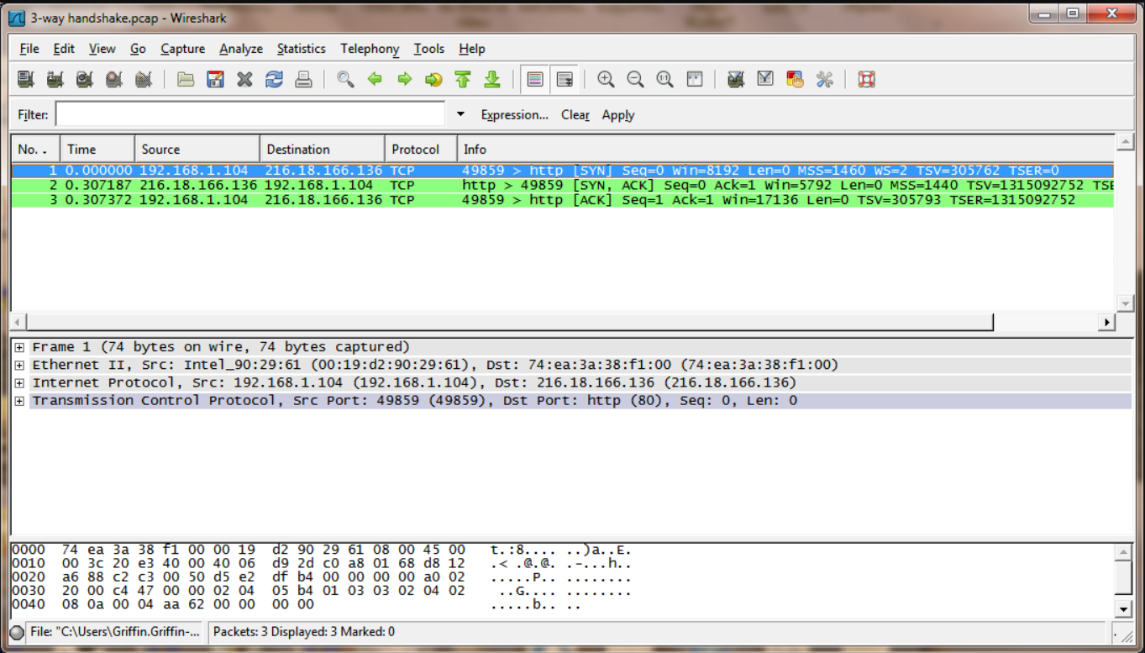
Wireshark Capture of TCP Hand Shake

Slide 13
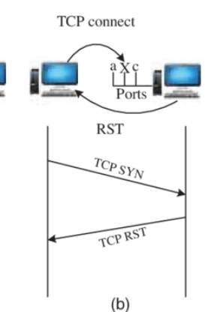
TCP Hand-Shake Closed Port
Sends RST packet instead of Syn-Ack
This one way tools knows that a port is closed!
A firewall may just drop the packet so that would-be scanners do not get a
response

Slide 14
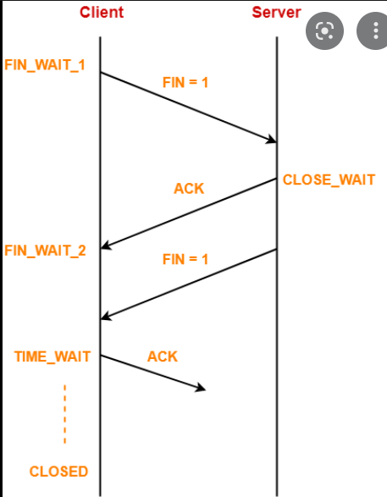
TCP Hand-Shake End Connection
4 Way Hand-Shake
Fin – Ack – Fin – Ack
The graceful way to end a connection

Slide 15
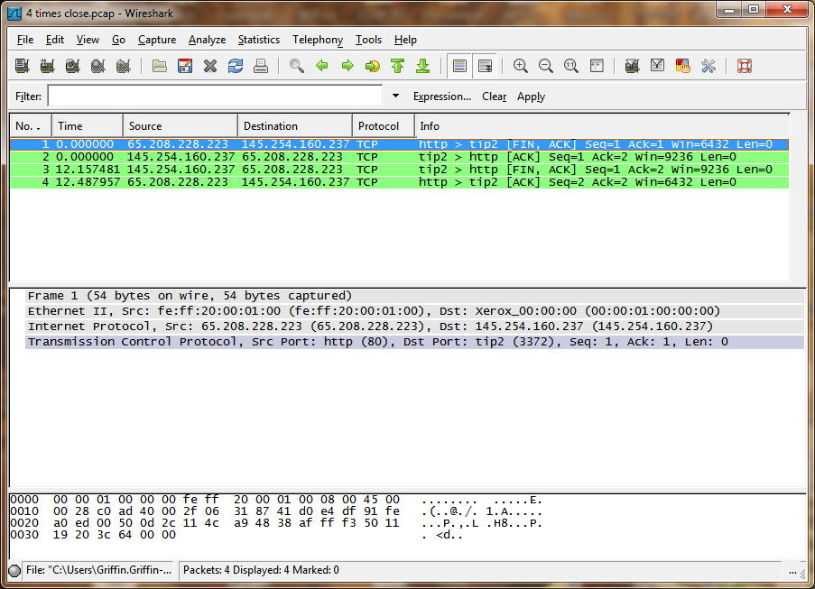
Wireshark Close Connection

Slide 16
Enough TCP!
Lets get to the good stuff

Slide 17
Legal Stuff
The legality of scanning networks with permission is a huge grey area
The Lug, UIC, and myself take no responsibility for your actions
Institutions (UIC) may ban you from their networks
Your workplace may fire you
The number one excuse used by hackers “I wasn’t trying to break anything, I just wanted to check for you!”
You can practice scanning on HTB, TryHackme, INE, other learning platforms
DO NOT SCAN THE GOD DANG UIC WIFI NETWORK

Slide 18
Nmap
The premier network “mapping” tool
A go-to by many pentesters
Also has a scripting engine to run Lua scripts

Slide 19
Nmap – Common Scans
Nmap TCP Connect Scan
Just uses the TCP Handshake to check open ports
Open = accepting connections
Closed = not accepting connections
Filtered = no response from target (host may be down, or firewall may have prevented a response)

Slide 20
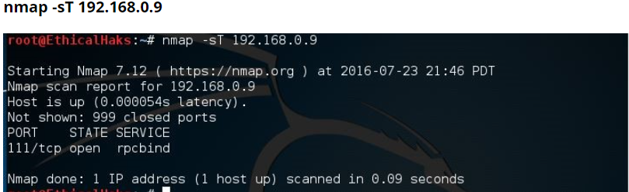
Nmap – Common Scans
Nmap sends a RST packet after connecting to drop the connection
If the port is closed instead of syn ack the target will send RST, ACK

Slide 21
Nmap – Common Scans
Nmap TCP “Stealth” Syn Scan
Scanner sends Syn Packet
Target responds with Syn Ack or RST
- Scanner does not complete TCP connection, just sends RST packet

Slide 22
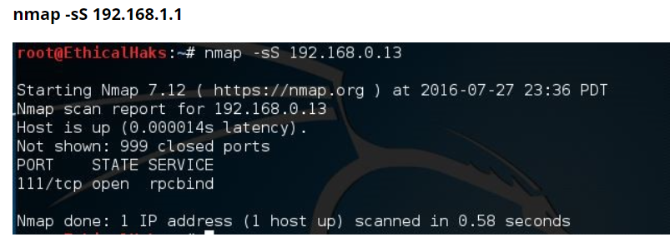
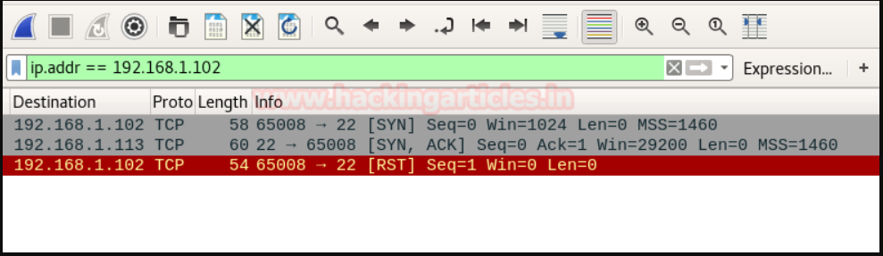
Nmap – Common Scans
This “half connection” helps bypass firewalls and is much quicker!

Slide 23
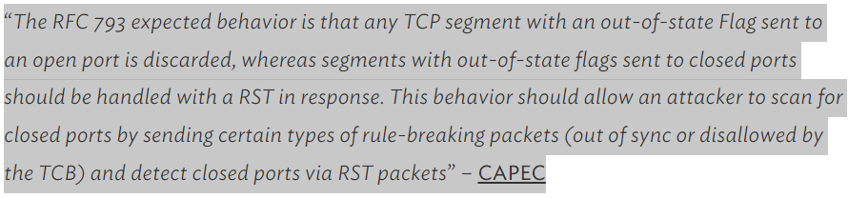
Nmap – Special Scans
TCP Flags tell you what type of TCP packet you are processing
TLDR: You can manipulate flags to figure out which ports are closed
Can be used to bypass firewall

Slide 24
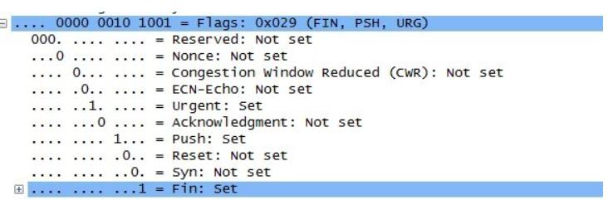
Nmap – Christmas Scan
nmap -sX
Fin Psh Urg flags are set to 1
Looks like a Christmas Tree

Slide 25
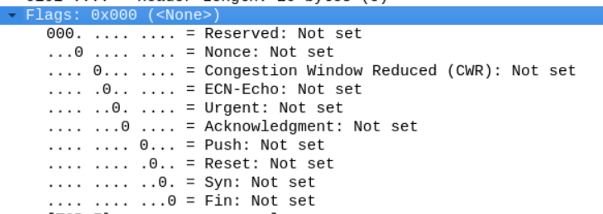
Nmap – Null Scan and Fin Scan
nmap -sN
All Flags are set to 0
nmap –sF
Only Fin Flag is set to 1
*Picture is of Christmas scan but can be used for reference*

Slide 26
Nmap Xmas, Null, Fin Initial Scan
Initial Scan
53/tcp open|filtered
80/tcp open|filtered
139/tcp open|filtered
445/tcp open|filtered
3389/tcp open|filtered
8080/tcp open|filtered

Slide 27
Nmap Xmas, Null, Fin Initial Scan
Final Scan
53/tcp open|filtered
80/tcp closed
139/tcp open|filtered
445/tcp closed
3389/tcp open|filtered
8080/tcp closed

Slide 28
Nmap – Zombie / Idle Scan
nmap –sI (uppercase i)
Use someone else to scan for you!
When a message is too big, it gets fragmented
TCP uses IPID Sequence counters to keep track of fragmented messages
If it the ID increments by 1, the port is closed
If it increments by 2, the port is open!

Slide 29
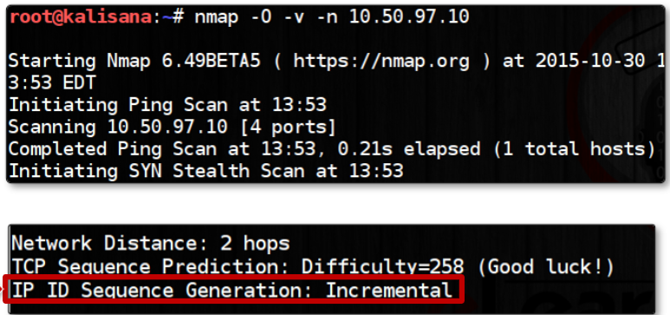
Nmap – Zombie / Idle Scan

Slide 30
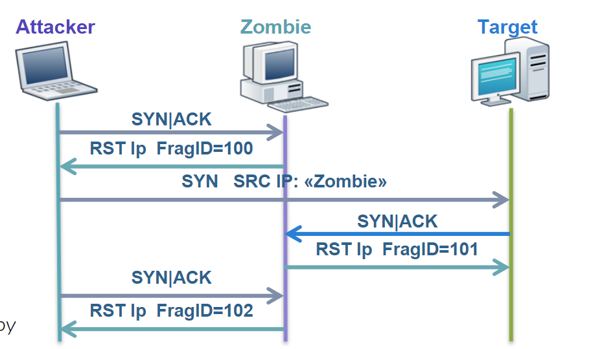
Nmap – Zombie / Idle Scan

Slide 31
DEMO:
Ine.com
Link to starter pass in reference slide

Slide 32
DEMO Notes
Show scanning from file names
Scanning ports
Different Scans
How OS – Guessing works

Slide 33
Other Tools
Hping3 – more customizable, less user friendly
Fping – Rapid Scanning
Amass – Rapid Scanning

Slide 34
References
Nmap Cheat Sheet : https://pastebin.com/4JxLYjTZ
Or just google Nmap cheat sheet
INE : https://checkout.ine.com/starter-pass
LUG Discord: https://discord.gg/cp4gAUcf - Expires 9-27-22

Slide 35


Thank You
Maciej Szwoch
UIC Cyber Sig

